Slide 1
The Cliffside Business Company

Slide 2
Who are we? Our Personal Tasks
Rachel Skonning
Angel Vivanco
Ben Jaynes
Luke Gaudiano
Data structures and the database, Admin class
UML, Documentation, Customer class
GUI, interface for admin/user, Volunteer class
Ensures Data and information gathered is sufficient for each class, Application uses multiple classes, Customer class

Slide 3
Cliffside Business Company: Application developer for management level jobs.
Our Customer: Aurora Food Pantry
Key Requirements :
1.The ability to register their volunteers and recipients of Charity. They need to track:
a. Last Name, First Name, Birthday, address, affiliation (e.g., company or organization), phone number, DOB, (if retired) , email, emergency contact: name and phone, Last updated by field
2. The Hours each volunteer works: Last Name, First Name, total hours (quarter increments) and date worked
3. Search -> Show the hours by Company, User, Court Ordered, Start date and end date.

Slide 4
User Stories: Admin
Value statement
As admin of (said company), I would like to have an application that allows me to easily access all of the information that is in the system.
As Admin, I can view my employee profiles and change them if necessary.
Acceptance Criterion
Have access to employee/customer profiles
Add/Delete employee/volunteer/customer profiles
Change data in employee/volunteer/customer profiles
Other Admin privileges
Secure log in
Definition of Done
Admin class (limited Admins, (1 -5 admins))
Admin will be able to add/delete to the data structures that hold employees and customers ( and can also edit/change personal information)

Slide 5
User Stories: Employee
Value Statement
As Employee of (said company), I would like to have access to necessary personal info such as residence in case I have a change in housing.
Acceptance Criterion
Access to personal info/Ability to edit certain personal info
Log in
Log working hours
See working hours for the week
Ability to see what’s in stock in inventory
Definition of Done
Employee class with 25 records
Can properly login and view their personal data and work hours
Can edit certain personal information, but Admin can edit all

Slide 6
User Stories: Volunteer
Value Statement
As Volunteer at (said company) I would like to be able to sign in and log my working hours.
Access Criterion
Log in
Log working hours with Admin approving these hours
See working hours for the week
Definition of Done
Can properly login and view their personal data and work hours
Volunteer class with 25 records

Slide 7
User Stories: Customer
Value Statement
As a Customer I would like to be able to RSVP available times for when I can visit the food pantry to get supplies.
Acceptance Criterion
View when the food pantry (store/site hours) is open or closing
Be able to contact certain employees for customer support
Ability to create personal login/account
View supplies available for them based on family size
Definition of Done
Can Register/Login and RSVP times.
Customer class with 25 records

Slide 8
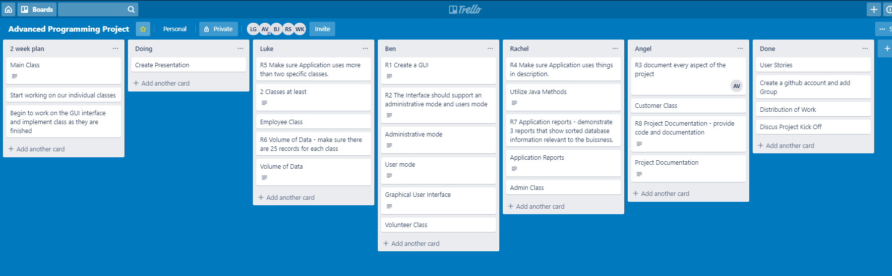
Trello Board
2 week plan: Work on main, Admin, Employee, Volunteer, and Customer classes

Slide 9
Obstacles
Time management
Having to learn or relearn information on how to use fxml, scene builder, github, etc.
How to put/pull info from Databases.
Learning how to properly build databases in MySQL.

